Slide 1
GDP Analysis

Slide 2
Section IA - GDP Analysis of the Indian States
Section II - GDP Analysis of the Indian States except Union Territories
Section III - GDP Analysis of the Categorised Indian States (C1, C2, C3, C4) (excluding Union Territories)
Section IV - Recommendations Section V - GDP and Education Dropout Rates

Slide 3
Section IA - GDP Analysis of the Indian States
This section includes all states except West Bengal, as data for West Bengal was unavailable at this stage.
The details covered include the average growth rate of all states for 2013-14, 2014-15, and 2015-16 compared to the All-India GDP (Page 4).

Slide 4
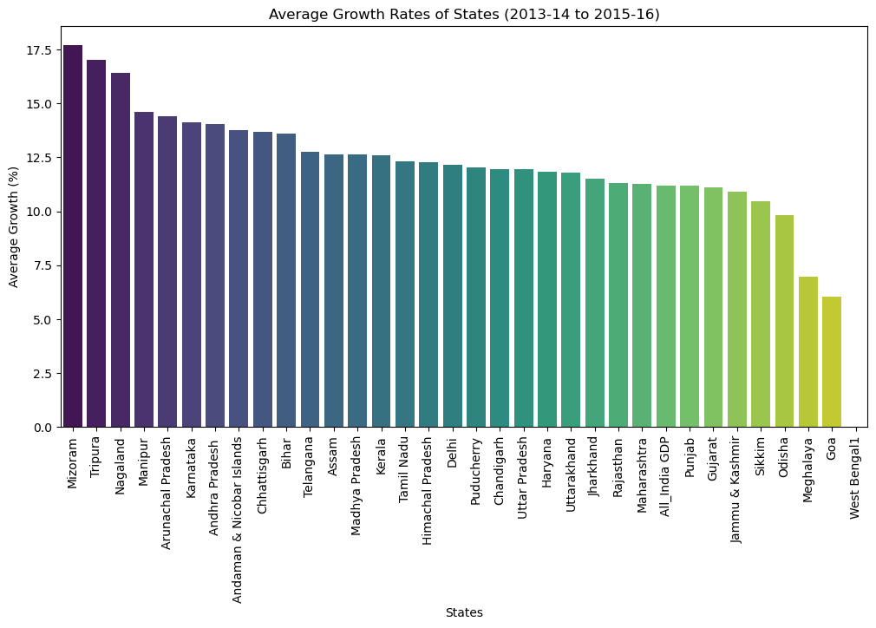

Slide 5
Average growth of states for 2013-14, 2014-15 and 2015-16
Top 3 states which are above overall GDP average growth rate (All India) ? - Top three states by average growth: Mizoram 17.700 ,
Tripura 17.030 , Nagaland 16.415
Bottom 3 states which are below overall GDP average growth rate (All India)? - Bottom three states by average growth: Goa 6.033333, Meghalaya 6.953333, Odisha 9.836667
Karnataka’s average growth rate? Above or below national average?- Average Growth Rate of Karnataka: 14.12%, Average Growth Rate of India: 11.20%, Difference in Growth Rate: 2.92% Ratio of Karnataka to India Growth: 1.26 .

Slide 6
GDP of the states for the year 2015-16
Top 5 states based on GDP?
Top 5 States by GSDP in 2015-16: Items Description GSDP - CURRENT PRICES (` in Crore)
Tamil Nadu - 1212668.0
Uttar Pradesh - 1153795.0
Karnataka - 1027068.0
Gujarat - 994316.0
Andhra Pradesh - 609934.0

Slide 7
GDP of the states for the year 2015-16
Bottom 5 states based on GDP?
Bottom 5 States by GSDP in 2015-16: Items Description GSDP - CURRENT PRICES (` in Crore)
Chandigarh - 30304.0
Meghalaya - 26745.0
Puducherry - 26533.0
Arunachal Pradesh - 18784.0
Sikkim - 16637.0

Slide 8
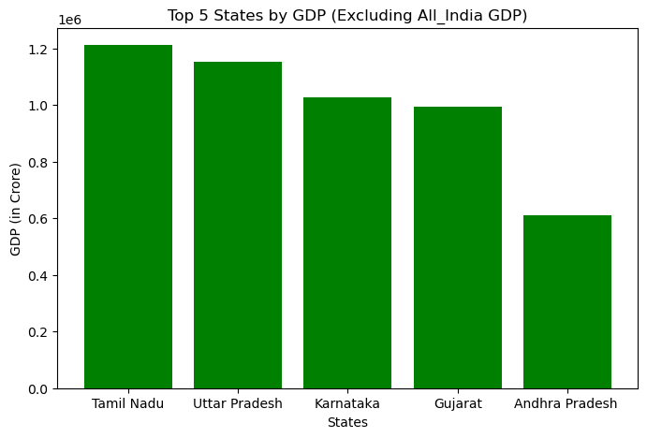
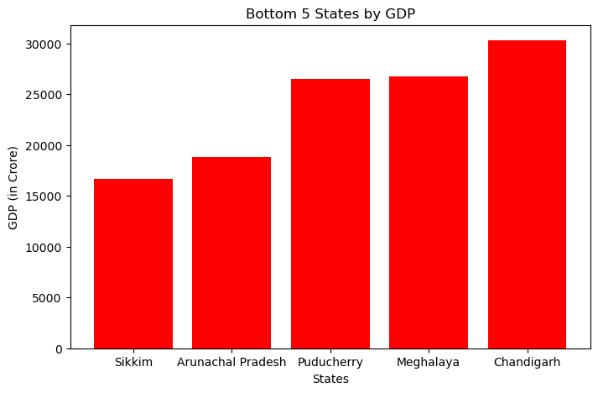

Slide 9
Section II - GDP Analysis of the Indian States except Union Territories
This section includes all states, except West Bengal and all Union Territories. This covers for other 28 states This section has majorly focused only for 2014-15 stats and cover below details
GDP per capita for all the states
Contribution of primary, secondary and tertiary sectors as percentage over GDP

Slide 10
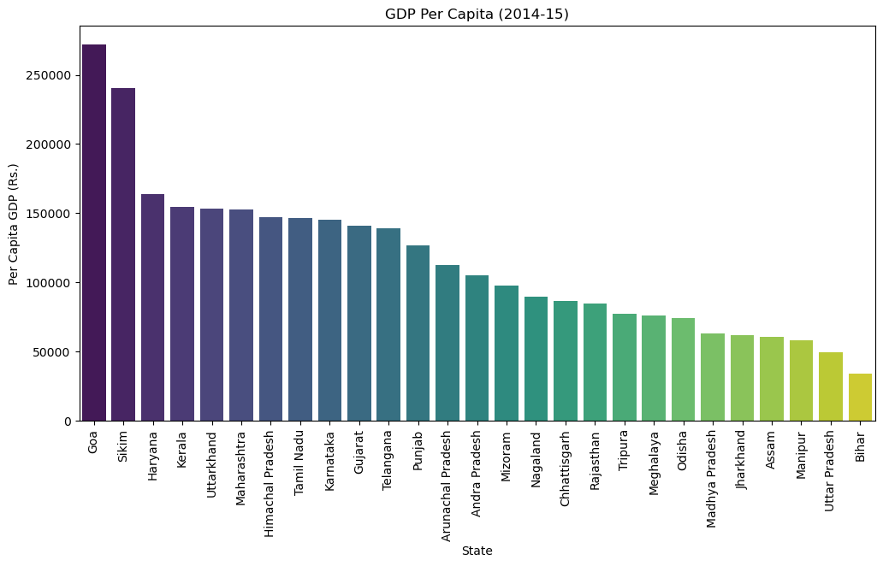
GDP per capita for all the states – 2014-15

Slide 11
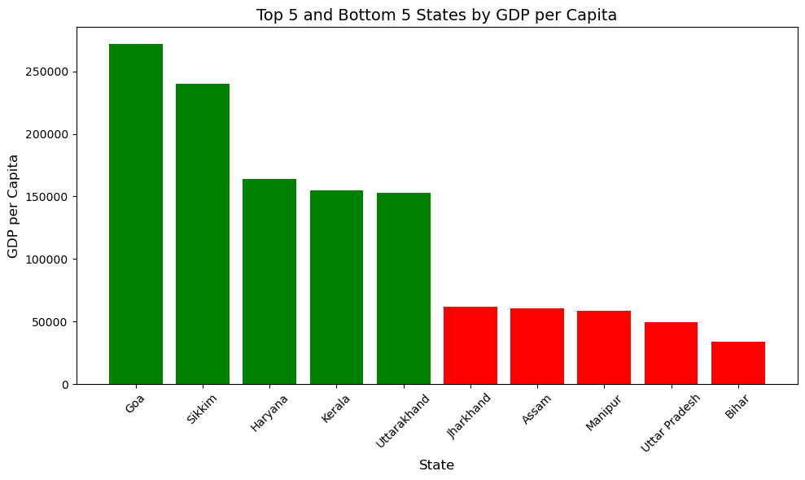

Slide 12
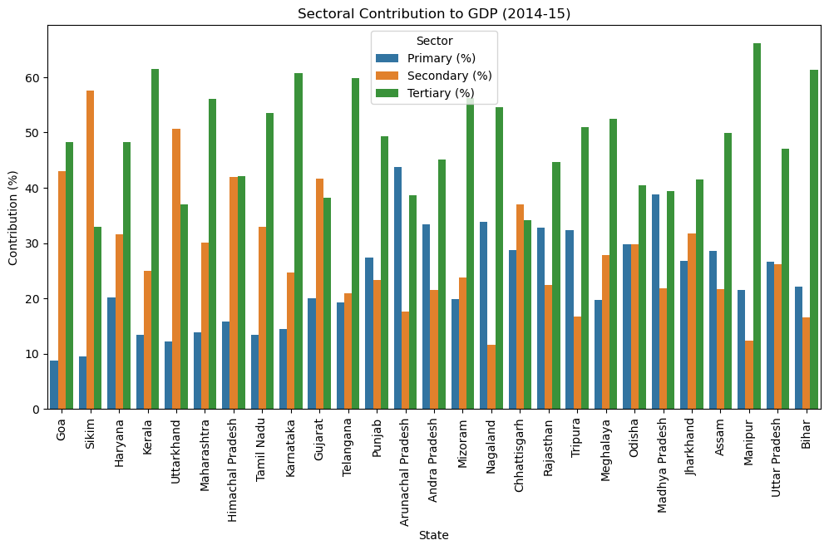
Contribution of primary, secondary and tertiary sectors as percentage over GDP

Slide 13
Section III - GDP Analysis of the Indian States except Union Territories
This section includes all states, except West Bengal and all Union Territories. This covers for other 28 states This section has majorly focused only for 2014-15 stats and cover below details
This section has additionally focused on dividing each states in to categories to understand which states are playing major role in contributing to GDP
Details of category split is covered in page 10 and below other details are captured
C1 States - Sub-Sectors contributing towards GDP (Page 11)
C2 States - Sub-Sectors contributing towards GDP (Page 12)
C3 States - Sub-Sectors contributing towards GDP (Page 13)
C4 States - Sub-Sectors contributing towards GDP (Page 14)

Slide 14
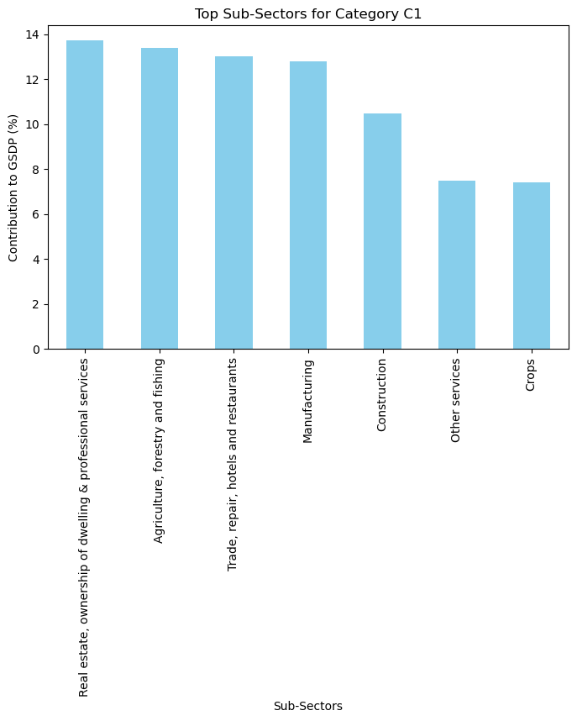
C1 States - Sub-Sectors contributing towards GDP
Top 5 State
Maharashtra
Uttar Pradesh
Karnataka
Gujarat
Tamil Nadu
Top 5 Sub category
Manufacturing
Real estate, ownership of dwelling & professional services
Agriculture, forestry and fishing
Crops
Financial Services

Slide 15
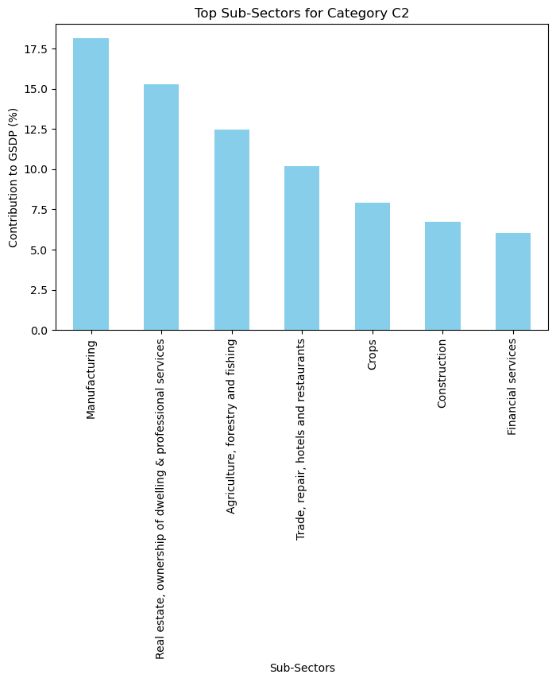
C2 States - Sub-Sectors contributing towards GDP
Top 5 State
Telangana
Karnataka
Bihar
Tamil Nadu
Uttar Pradesh
Top 5 Sub category
Agriculture, forestry and fishing
Trade & repair services
Trade, repair, hotels and restaurants
Other services
Transport, storage, communication & services related to broadcasting

Slide 16
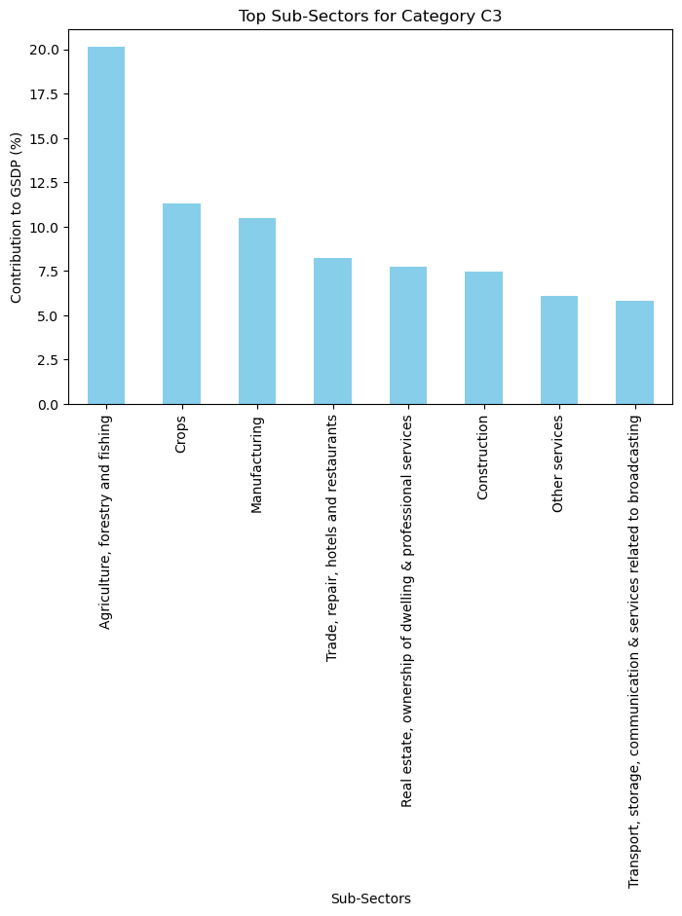
C3 States - Sub-Sectors contributing towards GDP
Top 5 State
Gujarat
Telangana
Chhattisgarh
Uttarakhand
Kerala
Top 5 Sub category
Forestry and logging
Communication & services related to broadcasting
Financial Services
Electricity, gas, water supply & other utility services
Fishing and aquaculture

Slide 17
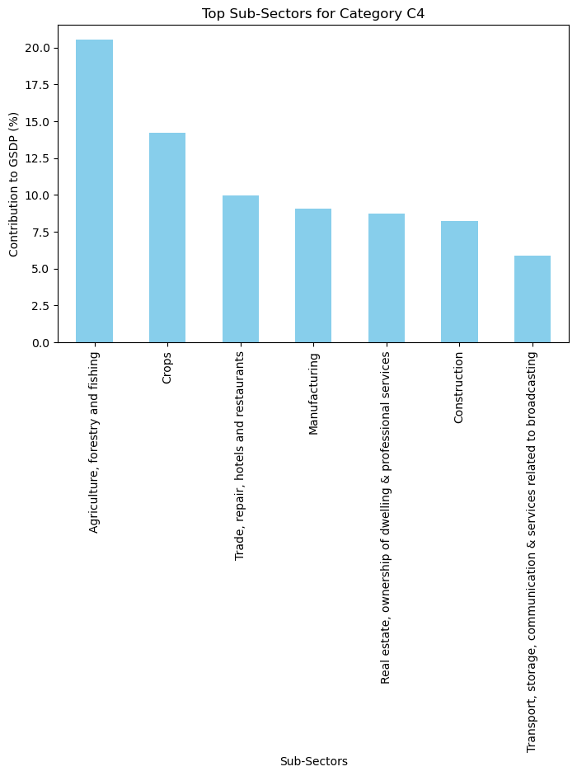
C4 States - Sub-Sectors contributing towards GDP
Top 5 State
Sikkim
Meghalaya
Andra Pradesh
Nagaland
Manipur
Top 5 Sub category
Trade & repair services
Financial Services
Forestry and logging
Trade, repair, hotels and restaurants
Road Transport

Slide 18
Findings / Recommendations
C1 - In 2014-15, Maharashtra dominated with significant contributions from Manufacturing and Real Estate, while Uttar Pradesh relied heavily on Agriculture. Karnataka and Gujarat also showed strong performances in Real Estate and Manufacturing. To improve per capita GDP, Maharashtra should focus on automation and affordable housing, Uttar Pradesh on agri-tech and agro-processing, and Gujarat on export networks and sustainable construction. Across all states, investing in education, skills development, and infrastructure will drive economic growth and increase productivity.

Slide 19
Findings / Recommendations
C2 - In 2014-15, Telangana had the lowest contribution from Agriculture, while Karnataka and Bihar saw significant contributions from Trade and Services. Tamil Nadu and Uttar Pradesh had strong contributions from Other Services and Transport. To improve per capita GDP, Telangana should focus on agriculture productivity and agribusiness, Karnataka and Bihar on expanding e-commerce and tourism, Tamil Nadu on technology-driven services, and Uttar Pradesh on improving transport infrastructure.

Slide 20
Findings / Recommendations
C3 - In 2014-15, Gujarat led with contributions from Forestry and Logging (1.29%), followed by Telangana with strong contributions from Communication & Broadcasting Services and Electricity, Gas, and Water Supply. Chhattisgarh had significant input from Financial Services, and Kerala from Fishing and Aquaculture. To boost per capita GDP, Gujarat should focus on sustainable forestry, Telangana on expanding broadband infrastructure and renewable energy, Chhattisgarh on digital finance, and Kerala on developing sustainable aquaculture.

Slide 21
Findings / Recommendations
C4 - In 2014-15, Sikkim had the highest contribution from Trade & Repair Services (2.18%), followed by Meghalaya with contributions from Financial Services and Forestry. Arunachal Pradesh focused on Trade, Hotels, and Restaurants, while Nagaland and Manipur contributed from Financial Services and Road Transport, respectively. To boost per capita GDP, Sikkim should enhance trade infrastructure, Meghalaya could develop financial tech, Arunachal Pradesh should expand tourism, Nagaland can strengthen financial services, and Manipur should improve road infrastructure.

Slide 22
Section V - Section V - GDP and Education Dropout Rates
Findings: The correlation matrix shows relationships between different education levels and overall GDP contributions in 2014-15:
2014-15 and overall GDP - 2014-15 have a negative correlation (-0.573), suggesting that as primary education levels increase, GDP may decrease or have a weaker positive relationship.
Upper Primary - overall GDP shows a positive correlation with Primary - 2014-15 (0.647) and a moderate negative correlation with 2014-15 (-0.523), indicating that higher primary education levels are associated with improved upper primary education, but may have a less direct positive effect on overall GDP.
Secondary - overall GDP has weak positive correlations with Primary - 2014-15 (0.176) and Upper Primary - 2014-15 (0.523), but a stronger negative correlation with 2014-15 (-0.449), implying that while secondary education and GDP show some inverse relation, secondary education correlates more with upper primary education.

